Slide 1
Scholarship that’s built to last:
Strategies for publishers, platform creators, and authors
Karen Hanson
Senior Research Developer, Portico
30th May 2022
Notes:
I’m Karen Hanson, the Senior Research Developer at Portico, and I’m going to talk about Scholarship that’s built to last.

Slide 2
Portico preservation service
Non-profit, community supported, digital preservation service
Work with libraries, publishers, and other content providers to preserve scholarly content so that it is available for future scholars
Notes:
If you’re not familiar with Portico, we’re a not for profit, community supported digital preservation service
We work closely with libraries, publishers and other content providers to preserve scholarly content so that it can be available for future scholars

Slide 3
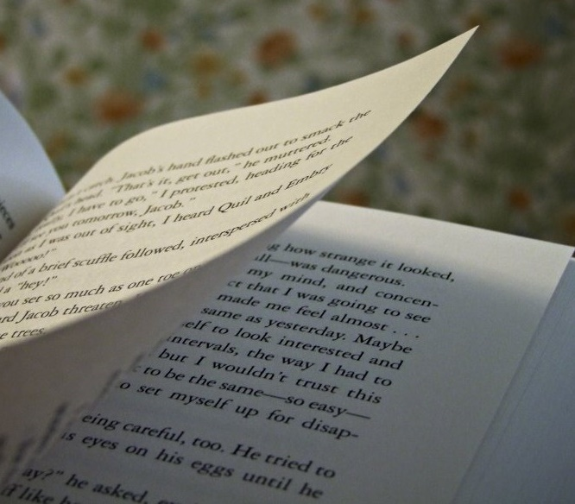
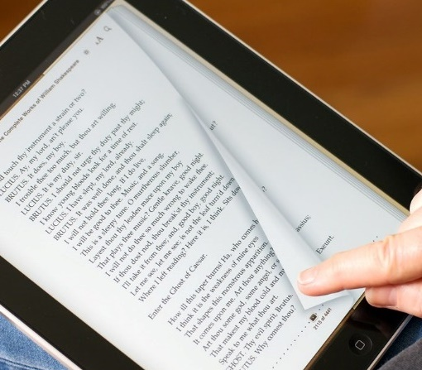
2005: E-publications as proxies for print
https://www.flickr.com/photos/owlpacino/3731874347
https://www.flickr.com/photos/pitmanra/4486630439
Notes:
When the service was founded back in 2005, electronic publications were typically made up of linear text and images –and they were easy to imagine in printed format.

Slide 4
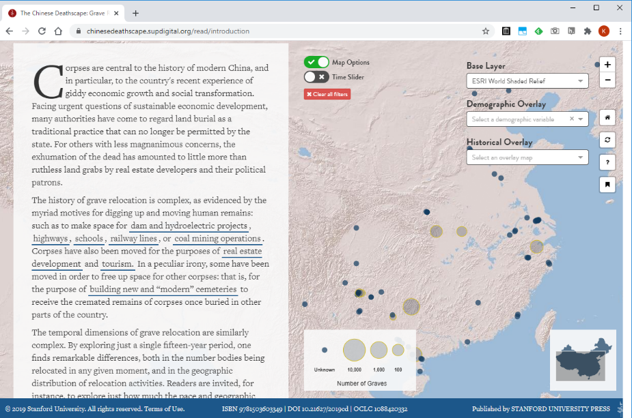
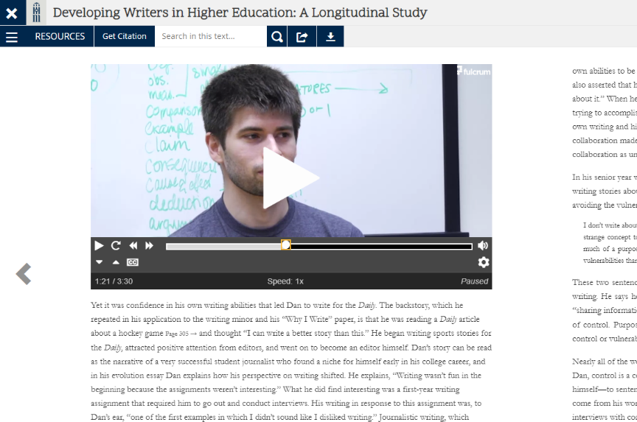
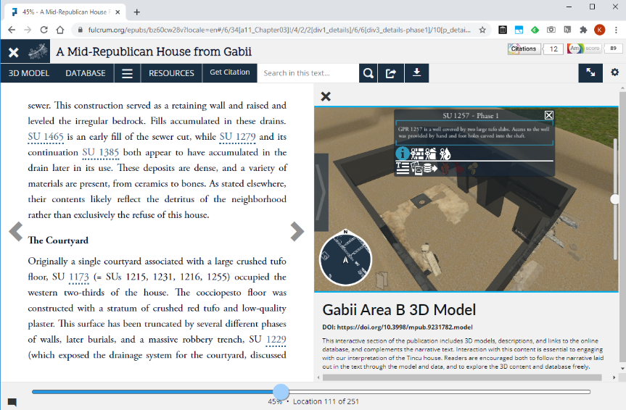
Beyond the print proxy: Can we preserve at scale?
https://doi.org/10.3998/mpub.10079890
https://chinesedeathscape.supdigital.org
https://doi.org/10.3998/mpub.9231782
Notes:
As publishing has evolved, we’ve started to see publications that have new kinds of features that can’t easily be represented in print.
They have things like embedded audio and video, non-linear navigation, data visualizations, and so on.
For Portico this means that the uniformity of those early digital publications, that allowed us to build our scalable preservation processes, may no longer apply for these new forms of scholarship.
So we started to wonder: is it still possible to preserve these publications at scale?

Slide 5
Enhancing Services to Preserve New Forms of Scholarship
Funded by Mellon Foundation, led by NYU Libraries
Preservation services (Portico and CLOCKSS) examined complex publications to see if they could be preserved at scale
Created recommendations to improve preservability
Notes:
To help answer this question, we joined a research project called Enhancing Services to Preserve New Forms of Scholarship that was funded by the Mellon Foundation and led by NYU Libraries.
In this research, preservation services (Portico and CLOCKSS) examined a range of complex publications to see what aspects of them could be preserved at scale.
Where scalable preservation was a challenge, the team created recommendations about what could have been done differently during the creation process that would have helped with preservation.

Slide 6
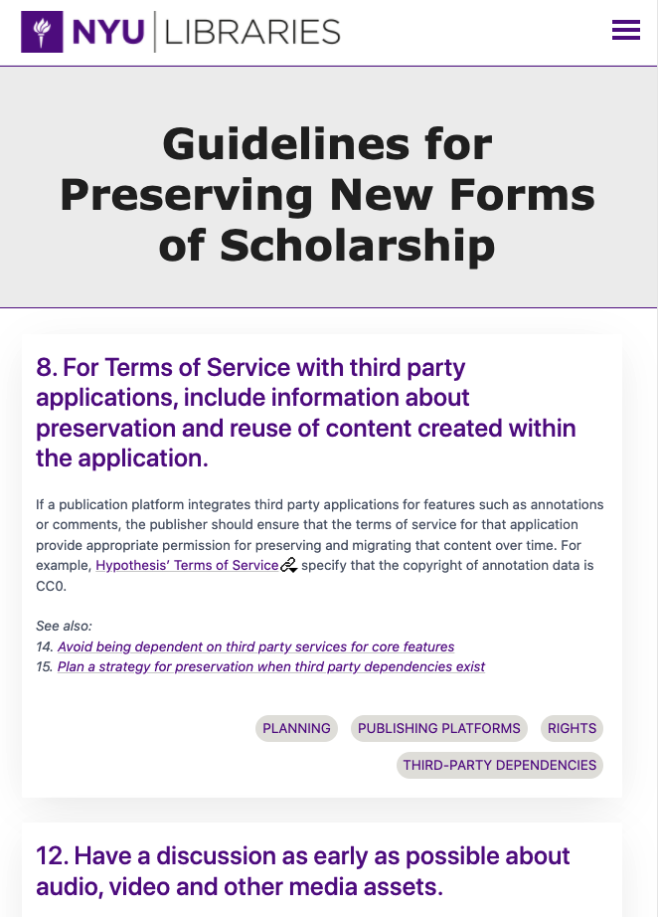
Guidelines for Preserving New Forms of Scholarship
68 Guidelines for creating complex forms of scholarship that are more preservable
For publishers, platform developers, authors
Can be adapted by preservation services to communicate requirements
https://preservingnewforms.dlib.nyu.edu
Notes:
This work culminated in what we call the Guidelines for Preserving New forms of Scholarship
These are 68 guidelines for creating complex forms of scholarship that are more likely to be preservable
They’re designed for use by publishers, platform developers, and authors but can also be adapted by preservation services to help communicate about requirements for preservation.

Slide 7
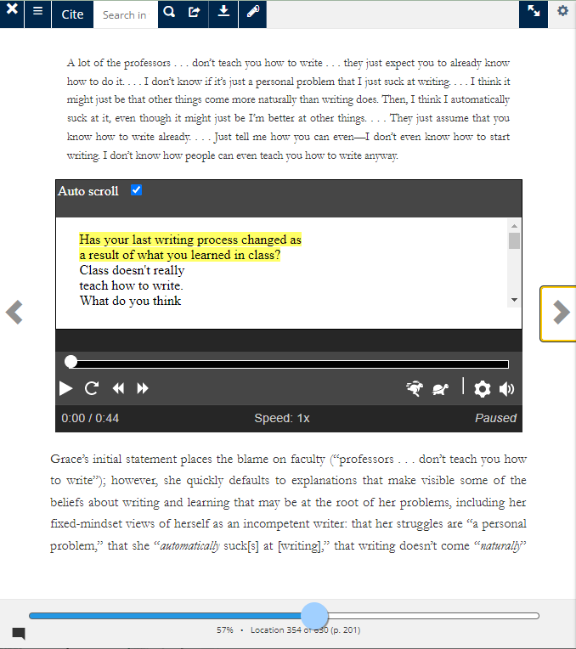
Features that can be challenging to preserve: Large volume of files and links
Audio file embedded in text
1 EPUB
283 PDFs
31 Videos
22 Audio
3 Images
Developing Writers in Higher Education by Anne Ruggles Gere. https://doi.org/10.3998/mpub.10079890
Notes:
I’m going to go through a few examples of the kinds of things the guidelines address –
The first thing we saw that was very common is that many publications have a large number and variety of resources associated with them… and these might be listed alongside the text as supplements, but they also might be embedded in the flow of the text, as the image on the right here shows, where is an audio player within the text.
As a preservation service we need to think about how to manage all of these different file formats but also how to keep track of the relationships between them.

Slide 8
Features that can be challenging to preserve: Large volume of files and links
Guidelines:
Include all components of the work in export packages
Favor broadly adopted, open, non-proprietary file formats
Create descriptive metadata and use unique identifiers for each resource
https://doi.org/10.3998/mpub.10079890
Notes:
The guidelines have suggestions about this. It suggests things like:
Ensuring that all components of a publication are in any export packages – sometimes we receive the text but not all of the additional files.
Also, favoring broadly used, non-proprietary, open formats where possible. This increases the chance we will be able to use it in the long term.
And finally, creating descriptive metadata and using unique identifiers for each resource is helpful because the extra metadata can provide useful context for preservation and unique identifiers help keep track of the different files and the relationships within the work even if some of the pieces end up in different repositories.

Slide 9
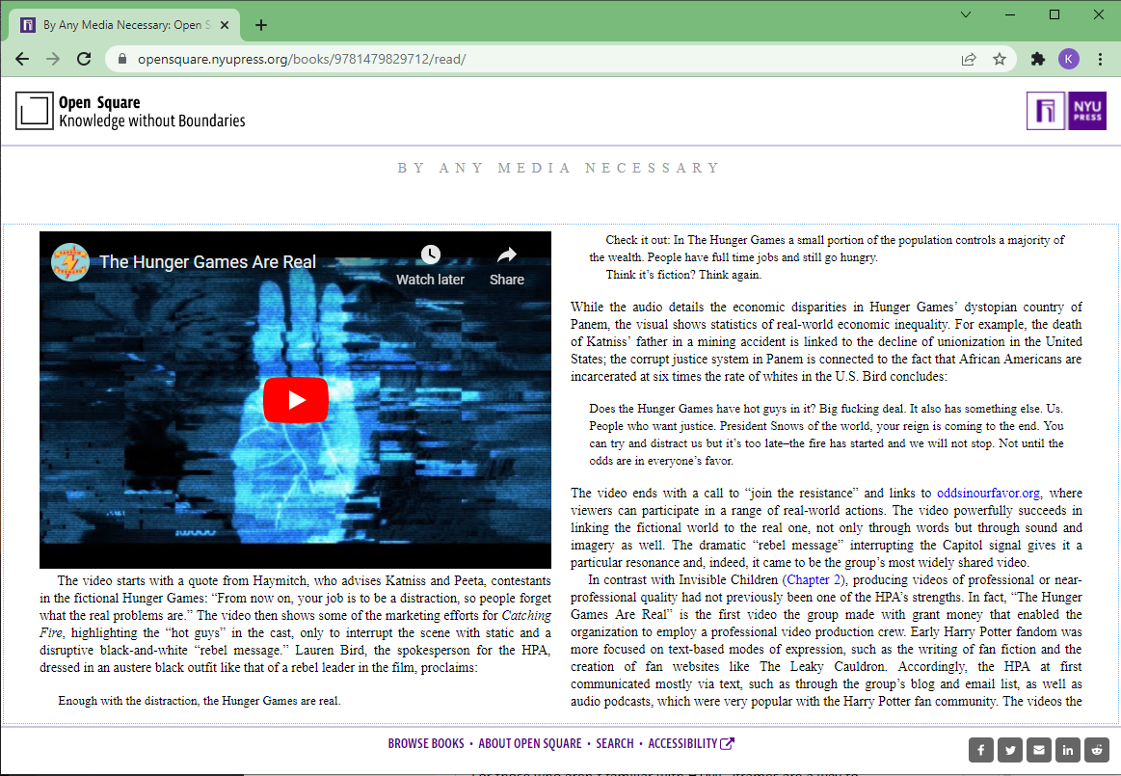
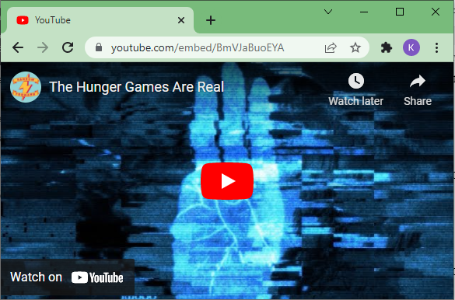
Features that can be challenging to preserve: Content hosted by third parties
By Any Media Necessary by Henry Jenkins, Sangita Shresthova, et al. https://opensquare.nyupress.org/books/9781479829712/
Notes:
A second big pattern we saw was that a lot of publications made use of third-party services to embed multimedia features and other kinds of features into the flow of the text.
A common example of this is to embed a YouTube video, but you could also embed things like Tweets, Google Maps, or ArcGIS visualizations, for example.
What often happens is when the content is transferred between platforms or sent for preservation it doesn’t include these embedded features because they’re not part of the publication. The copyright status might also be ambiguous, and they might break suddenly leaving a hole in your publication. All of this can affect our ability to preserve it.

Slide 10
Features that can be challenging to preserve: Content hosted by third parties
Guidelines:
Avoid depending on third party websites
When these services are used, store a local copy as backup
Add a caption under the embedded feature
By Any Media Necessary by Henry Jenkins, Sangita Shresthova, et al. https://opensquare.nyupress.org/books/9781479829712/
Notes:
The guidelines make some recommendations about this. They recommend, in general trying to avoid dependence on third-party websites because it introduces a vulnerability where they might eventually break.
Also, if you do use these services and decide to take that risk, making sure you have a local copy of the content as a backup. So, for example, you might ask the author for a copy of the video that they have on YouTube.
And finally, adding a caption under the embedded feature is useful so that if it ever breaks, the reader can have some information about what was there and what it was meant to portray – and maybe even enough clues to find a copy if there is one available.

Slide 11
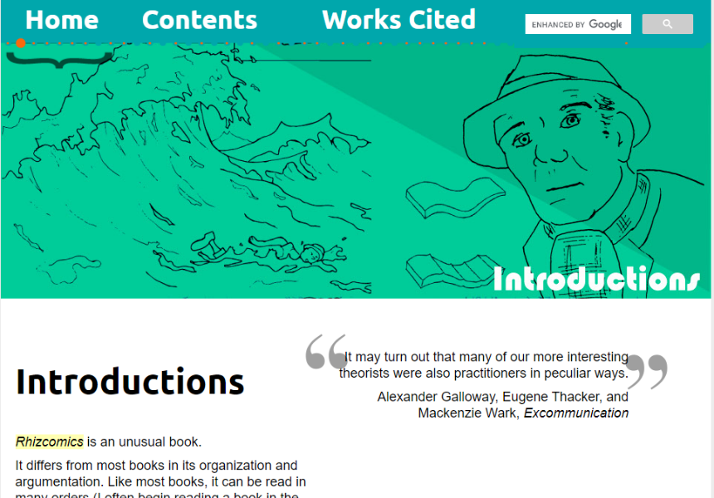
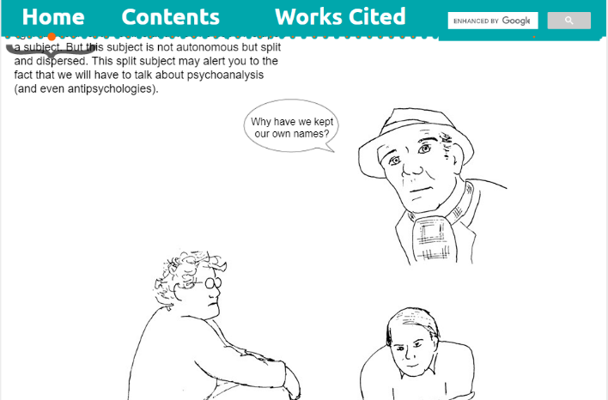
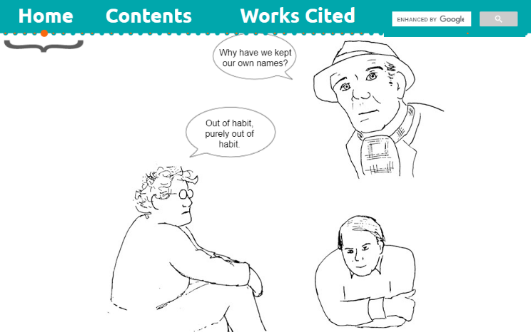
Features that are challenging to preserve: Preserving the experience
Rhizcomics by Jason Helms.
https://www.digitalrhetoriccollaborative.org/rhizcomics
Notes:
Finally, there were publications in which the experience, or the presentation of it, was a significant part of the work
This is an example, Rhizcomics. In this publication, as you scroll through the text it changes, and things appear and disappear.
So, you can’t easily separate the raw content from its specific presentation on the web.
In these cases, whether or not it can be preserved really comes down to how compatible they are with the processes we have available for preserving this kind of content.
For example, if we want to use website archiving, which is what the Internet Archive does - the quality of the results really depends on how the website has been designed and whether it works with that method.

Slide 12
Features that are challenging to preserve: Preserving the experience
Guidelines:
Add a sitemap to your website
Recommendations about use of JavaScript and format of URLs
Rhizcomics by Jason Helms.
https://www.digitalrhetoriccollaborative.org/rhizcomics
Notes:
The guidelines have a lot of suggestions about how to make sure a website is designed in a way it can be preserved using the techniques we have available
Things like adding a sitemap to the website so that a web crawler can so that a web crawler can find all of the content.
It has a lot of recommendations about things like use of JavaScript and how to format URLs in order to help these tools navigate the site.

Slide 13
Guidelines may align with other priorities
Descriptive metadata can improve discovery and accessibility
Avoiding dependence on third party services improves stability.
Making websites easier for web crawlers to navigate and read improves your search engine optimization
Notes:
What I’m hoping you might have noticed as I’m talking is that many of the guidelines don’t just have a positive impact on preservation, but they can help with other priorities.
For example, additional descriptive metadata can improve discovery of materials on your site, as well as accessibility if you’re adding text descriptions to resources.
Avoiding dependence on third party services makes the content less likely to break unexpectedly over time because you are in control of it, so it improves the stability of the publications.
Making websites easier for web crawlers to navigate and read improves your search engine optimization.

Slide 14
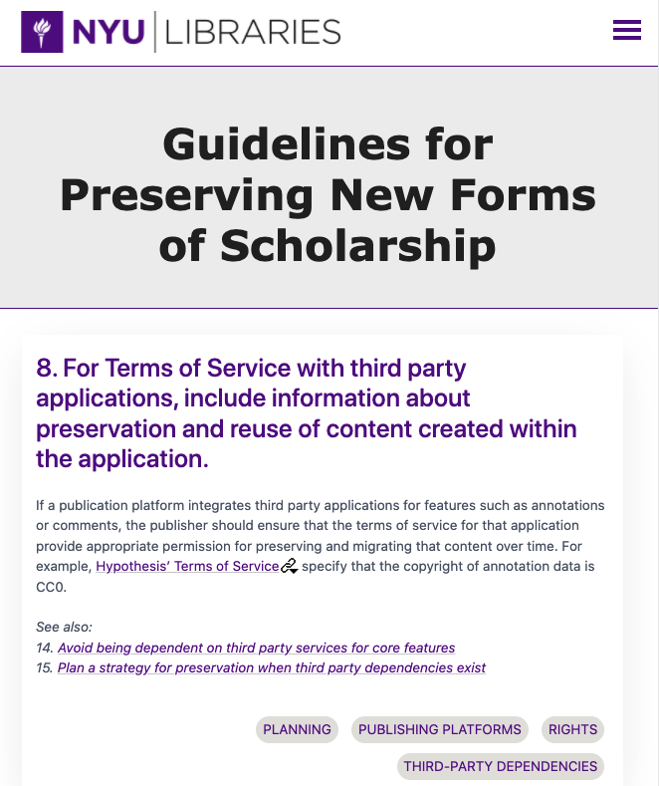
Next steps
New project: “Embedding Preservability”
Goal: Refine Guidelines based on evidence collected while embedding preservationists with publishers
Version 2
Notes:
To wrap up – we’re currently working on a follow-on project with NYU Libraries called “Embedding Preservability” – the goal is to refine the guidelines based on evidence collected by embedding preservation experts into publishing workflows.
As we’re working on this we’d also really like some feedback from the broader community.

Slide 15
Questions for you
What new forms of content are you creating, subscribing to, or preserving?
What are your concerns and how can we make the guidelines more useful for you?
Let’s collaborate to help create scholarship that’s built to last!
Version 2
Notes:
So if this work resonates with you, I hope that you’ll get in touch.
We’d really like to hear about what new forms of content that you’re creating, or subscribing to, or preserving.
What your concerns are about these and how can we make these guidelines more useful for you?
My hope is that through these conversations and by collaborating, we’ll find ways to create new forms of scholarship that are built to last.

Slide 16
Thank you
Karen Hanson
Senior Research Developer, Portico
karen.hanson@ithaka.org
Guidelines for Preserving New Forms of Scholarship:
https://preservingnewforms.dlib.nyu.edu
Notes:
Thank you, here is my contact info – and the link to our guidelines.

